Slide 1

EMAIL AUTOMATION USING BLUEPRISM
Project Supervisor: SR. Srividhya
Name of the Student: Mr. Saketh Reddy
Registration Number: 39111052

Slide 2
Presentation Outline
Course Certificate
Introduction
Objectives
System Architecture / Ideation Map
Application Snapshots
Results and Discussions
Conclusion & Future work
References

Slide 3
Course Certificate

Slide 4
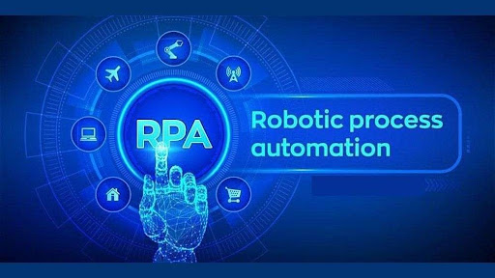
INTRODUCTION
Robotic Process Automation(RPA) is one of the most trending technology. It is an rapid adoption of RPA across various industries. This course is easy to learn and it produces the correct result without any deviation. This made me to get interest and do project in this course.
To create a bot that automatically send email with attachment to a list of people.
The main objective behind this is to get familiar with MS EXCEL VBO and EMAIL POP3_SMPT. This helps to send emails to a bunch of people.

Slide 5
OBJECTIVES
Gain insights into building blocks of blue prism automation.
Importing MS Excel VBO (Visual Basic for Applications) in Blue Prism.
Importing Email VBO (Visual Basic for Applications) in Blue Prism.
Tuning Process Studio with specific needs.
Working with different stages in the Process studio.
Building a bot to automatically send mails with attachments to a list of people.
Scope Of Project
RPA has provided an excellent solution for organizations to replace repetitive, mundane, rule –based processes with software bots.
It is now helping organizations who were looking to increase their.
First RPA was widely adopted in the IT sector.

Slide 6
SYSTEM ARCHITECTURE / IDEATION MAP
START
Configure the process studio
Import EMAIL SMPT-POP3
Import MS EXCEL VBO
Bind Process Studio With MS EXCEL VBO & EMAIL SMPT-POP3
Close MS EXCEL workbook
Turn Process flow with Blue Prism Actions
Specify Blue Prism Stages to work on MS EXCEL work book
Open MS-EXCEL workbook
Turn on process flow with Blue Prism actions
END

Slide 7
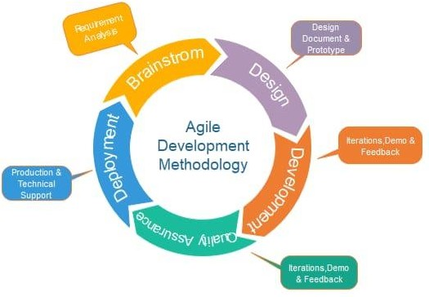
METHODOLOGY
Agile methodology is a practice which promotes continues interaction of development and testing during the SDLC process of any project. In the Agile method, the entire project is divided into small incremental builds. Through this project, we can create a system that will automatically sends the certificates to candidates through email with a particular subject line and body of email.

Slide 8
PROJECT IMPLEMENTATION
Hardware/Software requirments :
1.Windows 8.1 or higher(64-bit version)
2.Minimum 10GB free disk space
3.500megahertz(MHz)
4.256 megabytes(MB) RAM
5.1.5 gigabytes(GB) available space
6.1024x768 or higher resolution monitor
7.Blue Prism software
8.Microsoft Excel 2013 or higher

Slide 9
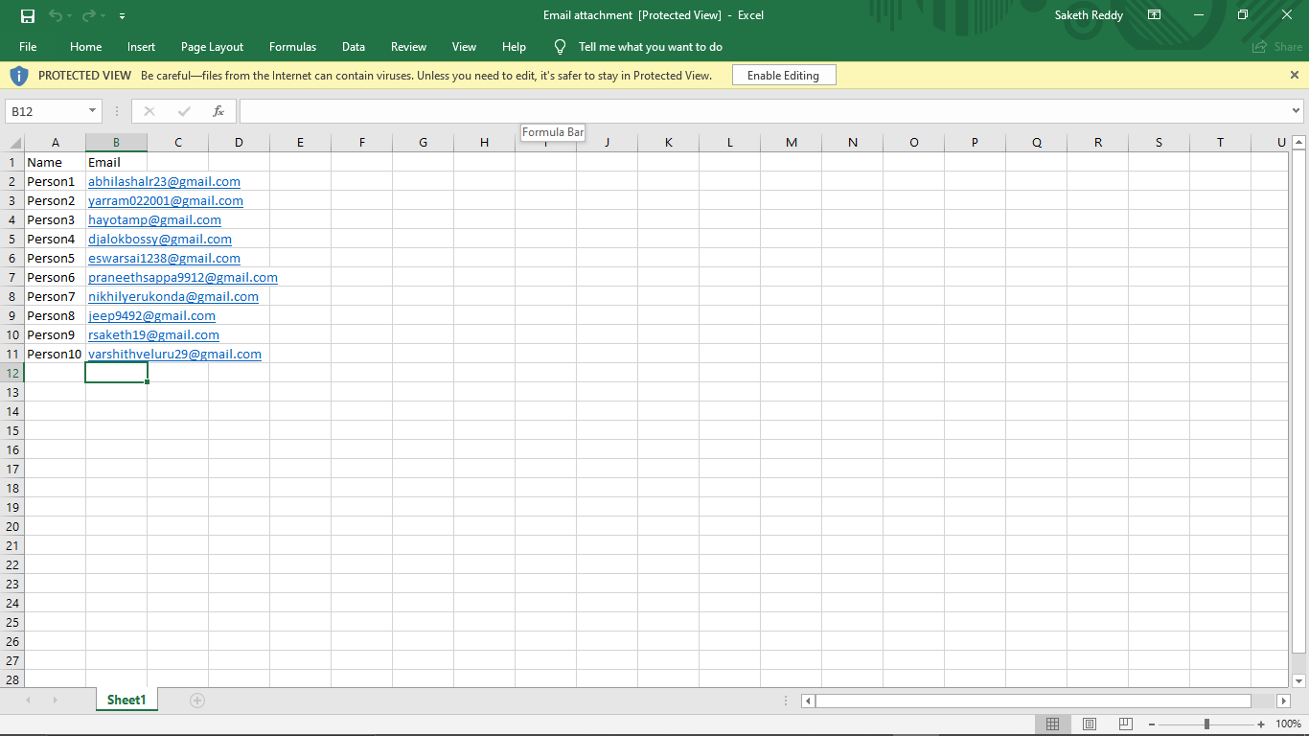
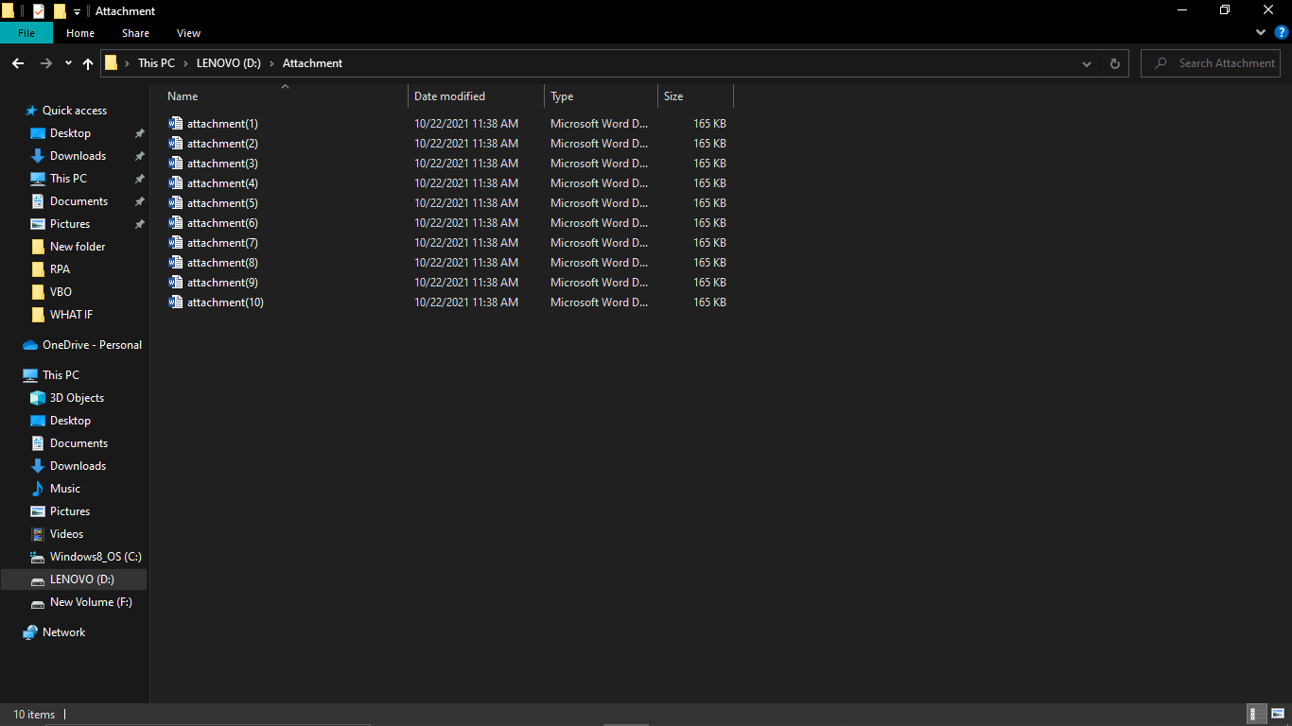
STEP – 1 STEP - 2
First store name and email id’s in excel sheet Store the attachments in a folder to add in email

Slide 10
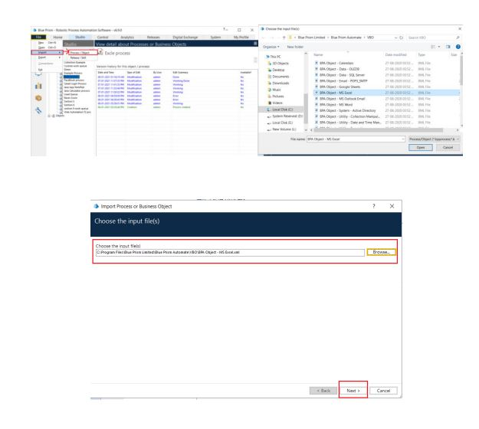
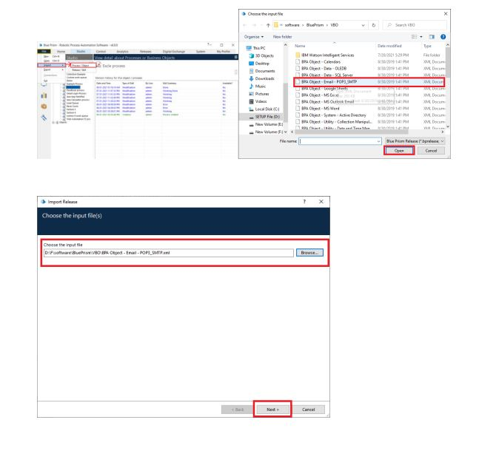
STEP-3 STEP – 4
MS Excel VBO (Import VBO file) Email VBO(Import VBO file)
File -> Import -> Browse -> (C:\Program Files File -> Import -> Browse ->(C:\Program Files\
\Blue Prism Limited\Blue Prism Automate\VBO Blue Prism Limited\Blue Prism Automate\VBO
\BPA Object - MS Excel). Click Finish. \BPA Object – Email). Click Finish.

Slide 11
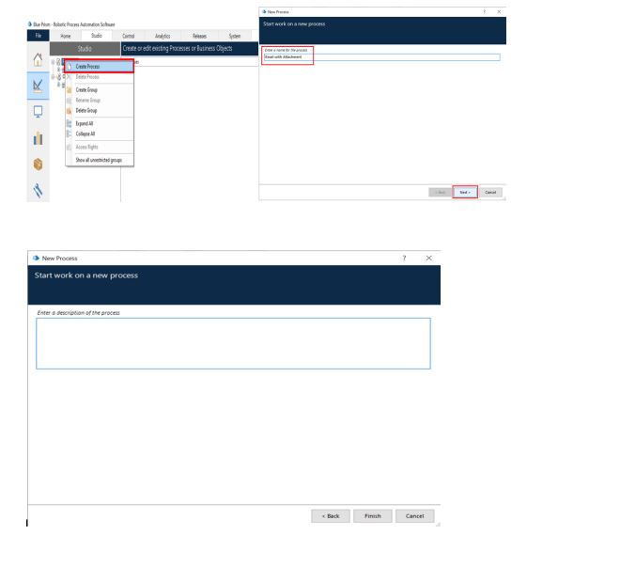
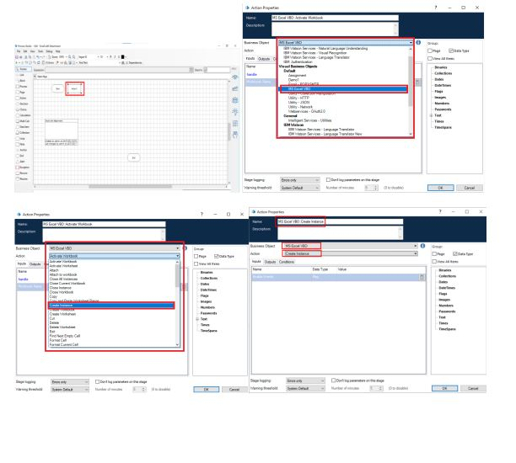
STEP- 5 STEP - 6
Create a process After launching the Blue Prism Create an action stage, select MS Excel VBO
,Open Studio tab, right-click on process, and from Business object drop down, select Create select Create process. The screenshots clearly Instance action. Create Data Item as follows, explain the process of creating process. 1.Type = number 2. name = “handle”

Slide 12
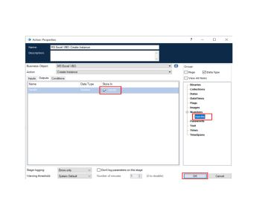
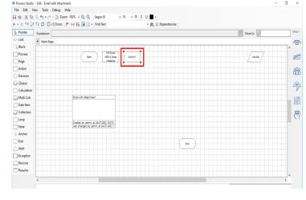
Go to output tab & drag it into store in STEP - 7
Column, click on ok . Create an action stage, select MS Excel VBO from
Business object drop down, select Open Workbook action. Create Data item as follows type = text; name =” Workbook name”.

Slide 13
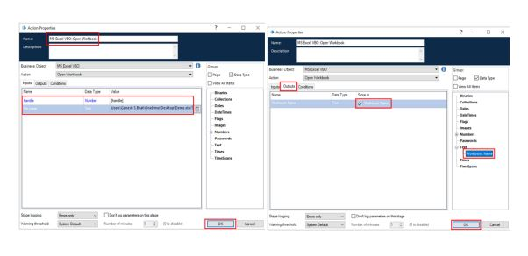
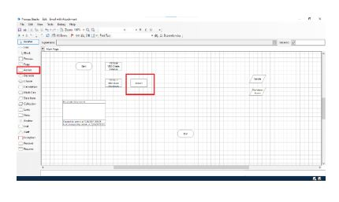
Go to output tab and drag it into Workbook STEP - 8
Name column, click on ok. In the input tab Create an action stage, select MS Excel VBO from give the handle and path of the excel file. Business object drop down, select Get workshet as collection. Create Collection with fields as follows, type = text; name =” Name” type = text; name= “Email”.

Slide 14
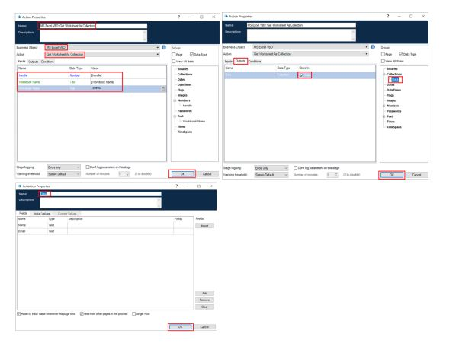
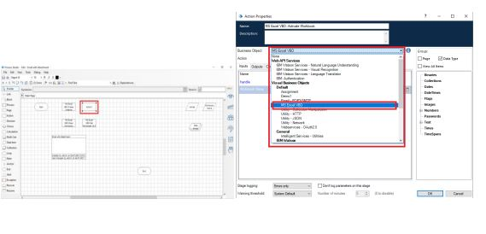
Go to output tab and drag it into Workbook STEP - 9
Name column, click on ok. In the input tab Create an action stage, Select MS Excel VBO give the handle, workbook name and name from business object drop down, select close of sheet in excel file. Close instance action.

Slide 15
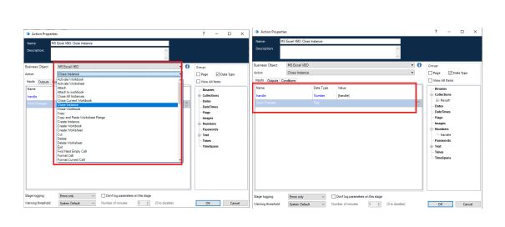
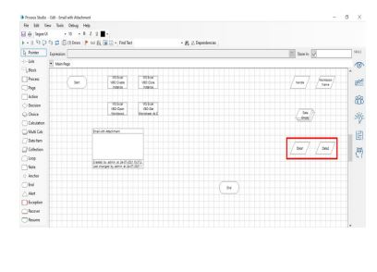
Drag and drop the handle, give the file STEP - 10 name, click on ok. Add two new data items
- To store the Email - 1.Initial value – your mail ID
2.Name – email 3.Type - text

Slide 16
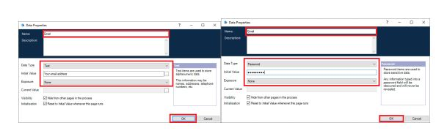
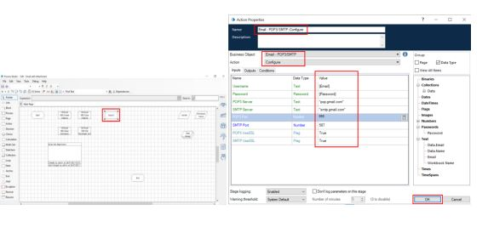
-To store Password - 1.Name – Password STEP - 11
2.Type – Password 3.Initial value – Password Create an action stage, select Email VBO from Business of your email id object drop down, select Configure action. In the input tab give the Email and Password and the give the following details: 1. POP3 Server = "pop.gmail.com"
2. SMTP Server = "smtp.gmail.com" 3. POP3 Port = 995
4. SMTP Port = 587 5. POP3 Use SSL = True
6.SMTP Use SSL = True Click on ok

Slide 17
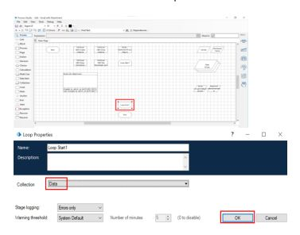
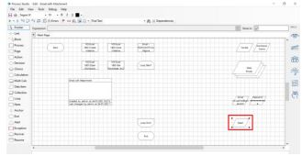
STEP – 12 STEP-13
Add a loop stage and make it to loop for Add two data times Data collection. Drag and drop a loop stage and change the arrangement of all 1.To store the path of the attachment(only the the stages in the page, double click on it constant path).For numerical part we will be and in the collection drop down select data using calculation stage. collection

Slide 18
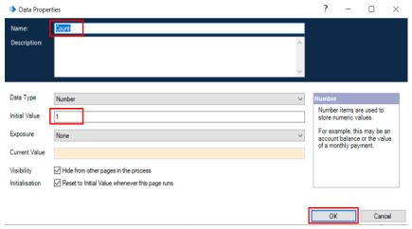
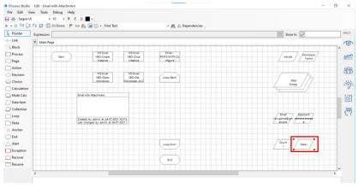
• Name – Path • Type – Text • Initial value – constant values in the attachment path
2. To store the number to increment the path for each attachment
• Name – Count • Type – Number • Initial value – 1

Slide 19
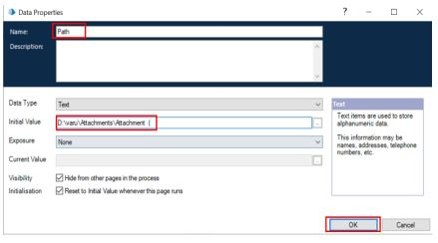
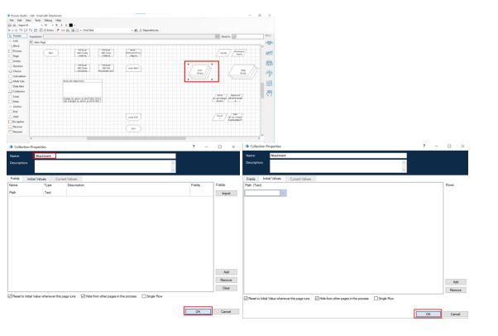
STEP – 14
Drag and drop a collection, rename it as
Attachment and give the following as initial fields
Name – Path; type – Text
Create a row in initial values column.

Slide 20
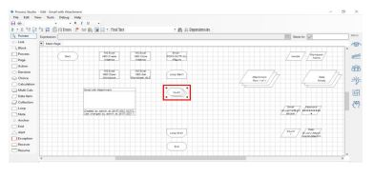
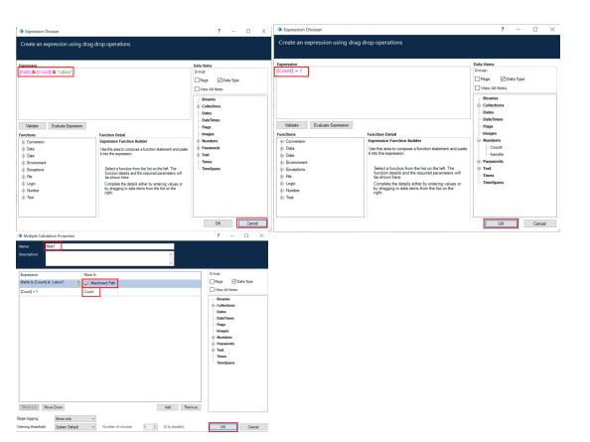
STEP-15
Add a multi calculation stage to store the path to Attachment collection and to calculate path. Drag and drop a multi calculation stage, double click on it and add the following: • Calculate the path and store it in Attachment collection. • Increment count.

Slide 21
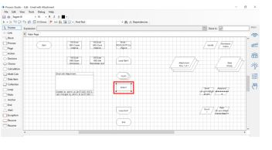
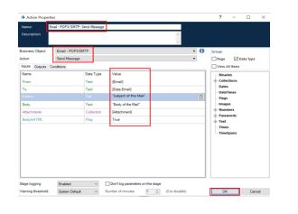
STEP – 16
Create an action stage, select Email VBO from Business object drop down, select Send message action. In the input tab give the following details: • From = Email data item • To = Email from data collection • Subject = The subject you want to send • Body = The body you want to send
• Attachment = Attachment collection. And then Click on ok

Slide 22
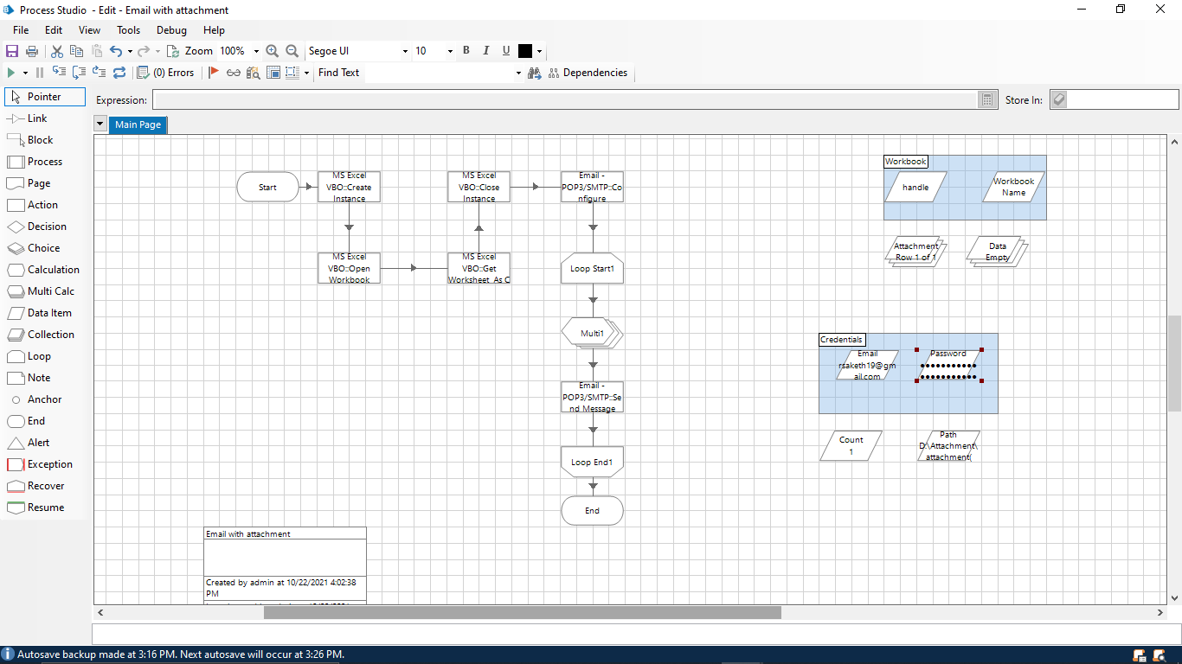
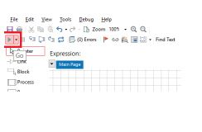
STEP – 17 STEP – 18
Link all the stages and run the bot at different Testing the process object from process studio timings to notice getting login to different click on main page, click on green run page to run classes. Do Proper connections (Links). the Web Automation T2 process’ process object.

Slide 23
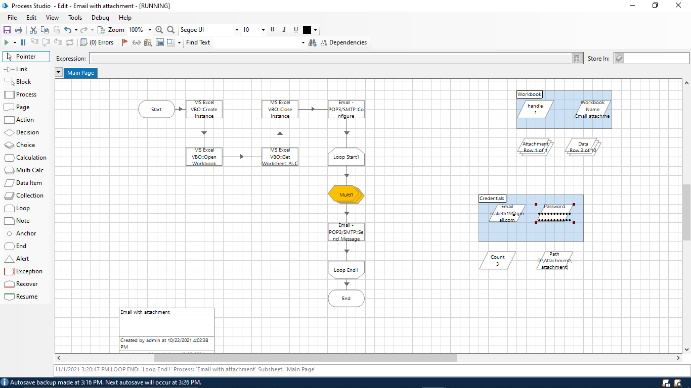
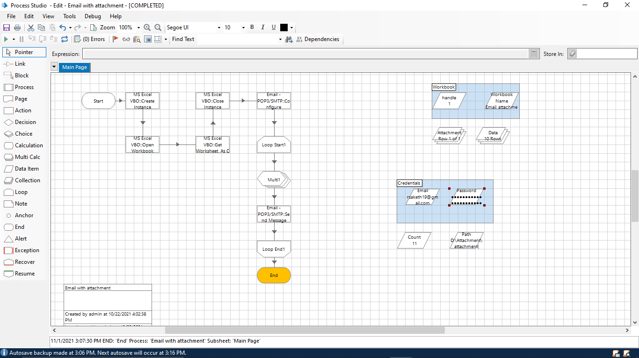
APPLICATION SNAPSHOTS

Slide 24
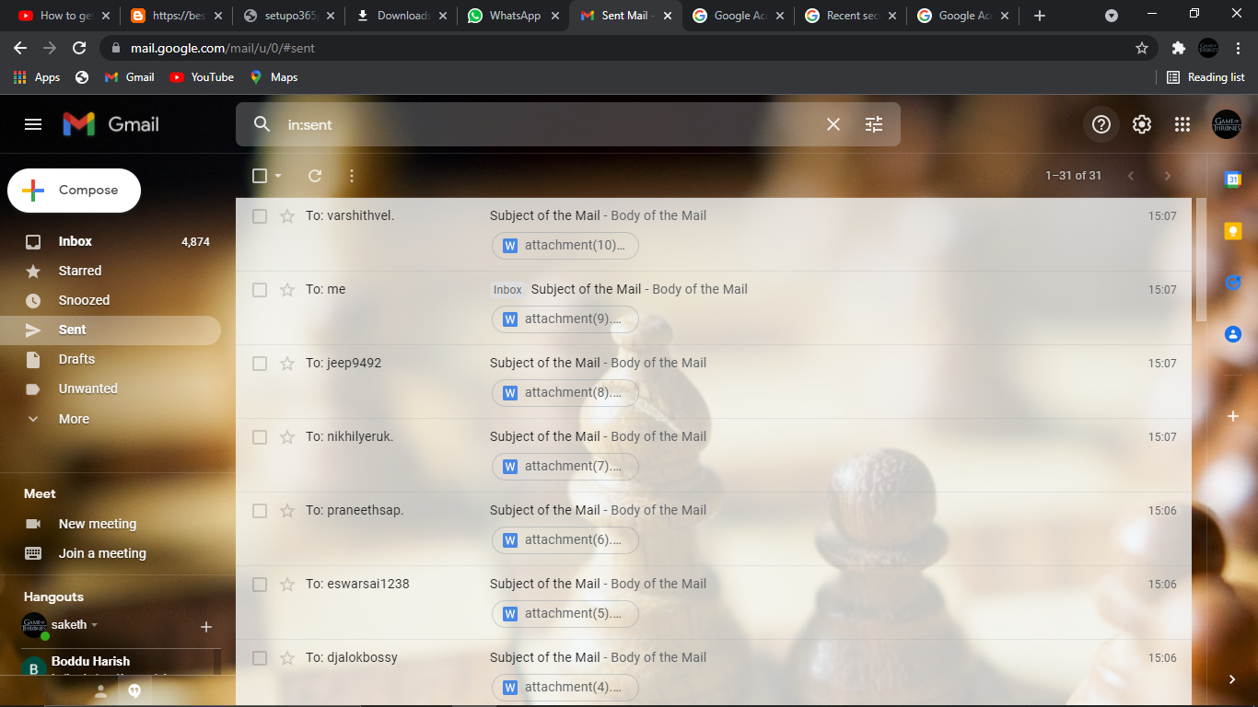
RESULTS AND DISCUSSION
The Above Picture Shows. That we have successfully sent Email with the attachment To the list of people where attached in the Excel sheet.
Email automation is now a digital marketing staple, replacing the tedious task of manually sending emails to every customer with preconfigured workflows. You can specify what communication should be triggered in response to each customer’s behavior. This lets you map a variety of customer journeys and ensure optimum engagement with your brand.

Slide 25
CONCLUSION
At first we have to store the each person email id in Microsoft Excel and save it for later use. Then we have to import MS-EXCEL VBO and Email SMTP-POP3 VOB into the Blue Prism , then create the process and then we have to give the following actions such as create instance , opening excel file , getting email id's , closing the excel file , Configuring Email, fetching the attachments and then sending the mails. Click on refresh button then click run button to run the program. Then the resultant output will be emails sent with the attachment.
In future many developments will take place in this email automation. This technique will become a lot more useful to develop the email marketing. Almost 80-90% population use this top gen tool.

Slide 26
REFERENCES
[1] M. Lacity, L. P. Willcocks, & A. Craig. Robotic process automation at Telefonica O2.The Outsourcing Unit Working Research Paper Series, 2015[
2] IRPA, “Introduction To Robotic Process Automation,” tech. rep., 2015.
[3] H. P. Fung "Criteria, use cases and effects of information technology process automation (ITPA)." Advances in Robotics & Automation 3 (2014).
[4] Dana Nau, Malik Ghallab , and Paolo Traverso Automated Planning: Theory & Practice. Morgan Kaufmann, 2014.
[5] M. Barrett, E. Oborn , W. J. Orlikowski , and J. Yates, “Reconfiguring 4Relations: Robotic Innovations in Pharmacy Work ,” Organ. Sci., vol. 23, pp. 1448– 1466, 2012.

